Slide 1
Using Spotify to Predict Billboard Top 100 Songs
BA476
Professor Gerdus Benade
Team 2: Tristan Tew, Claire Choi, Rebecca Chang, Brett Rado

Slide 2







Executive Summary
The Problem & Stakeholders
Data Sourcing, Transformations, & Cleaning
Descriptive Analytics & Observations
Predictive Methods & Model Accuracies
Obstacles & Response
Conclusions
BA476 Team 2
Notes:
Brett
Just list off Summary

Slide 3




Predicting Commercial Viability for a Song Creates Value for Multiple Parties
The Problem: Predicting whether or not a new song will end up on the Billboard Top 100 list based on its Spotify information
Stakeholders
Artists
Maximizes potential song popularity
Influences what music to produce for commercial viability
Spotify
Determines if songs are predisposed to becoming a hit
Allows proactive promotion
Bolsters customer satisfaction & retention
Record Labels
Optimizes profit
Helps decide what songs to release
Facilitates analysis of commercial viability of releases
Influencers
Enables first-movement on new trends
Maximizes social media viewership
BA476 Team 2
Notes:
Brett

Slide 4
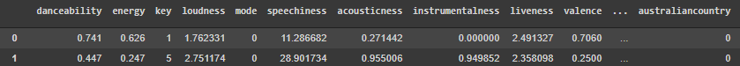
Kaggle and Python API Allow us to Add Over 300 Features to the Model
The Dataset: The Spotify Hit Predictor Dataset for 2010’s (Kaggle)
Cleaning Process:
Added features to songs from Spotify API
Generated 312 from Binary Genre Variables
Added polynomial features and converted categorical variables
Cleaned Dataset:
Rows: 6344
Predictors: 374
Types: Numerical, Boolean,
Train/Test: 80/20
Raw Dataset:
Rows: 6398
Predictors: 15
Types: Numerical, Boolean, Categorical
BA476 Team 2
Notes:
Brett
https://www.kaggle.com/theoverman/the-spotify-hit-predictor-dataset?select=dataset-of-10s.csv

Slide 5
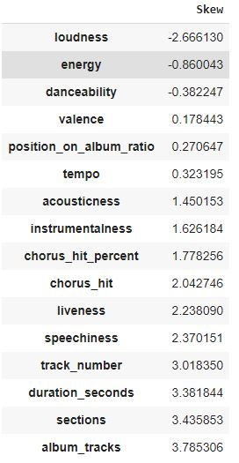
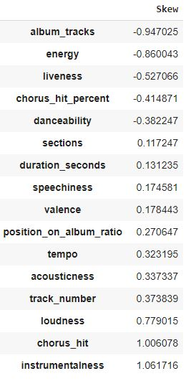
Handling of Null Values and Outliers with
Log and Power Transformations to Reduce Skewness
Skewness Before
Skewness After
Null Values and Removal of Rows:
54 rows were removed from the dataset because their genres column was blank
There were no null values the final dataset
Outlier Wrangling:
|Skewness| > 1 as the rule for outliers for 16 numerical features
Log, power, and reciprocal transformations were applied to mitigate skewness
BA476 Team 2
Notes:
(becca)
As mentioned by Brett, out team added dummy variables for the top 50% most frequent song genre’s. However, we actually had a few song instances that had no genre’s. Because there were only 54 of these instances, we removed them completely to avoid having null values. Furthermore, we had to deal with the skewness, and different forms of our data. After finding the skewness of our predictor values, we decided that if the absolute value of the skewness was greater than 1, we should do some form of standardization. We utilized log, power, and reciprocal transformations to adjust the skewness of our data. As you can see in the graphic on the right, the absolute value skewness decreases significantly after the standardizations.

Slide 6
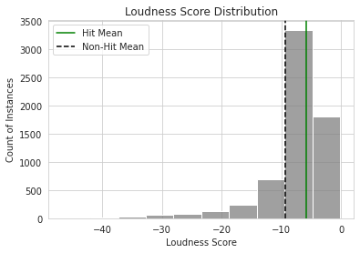
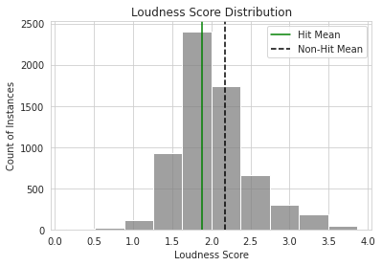
Transformations Example: Log
f(x) log(1 + -x)
BA476 Team 2
Notes:
(becca)
Here is an example of the loudness score transformation. We performed the log transformation because our original data was extremely skewed to the left.
We want to present and examine our data in a way that’s easier to understand and feed more “normal” data into our models. We also wanted to avoid removing data points that seemingly look like outliers because it is possible that their distance from the average is meaningful.
We recognize that these transformations decrease the interpretability of our project but does contribute to the prediction accuracy.

Slide 7
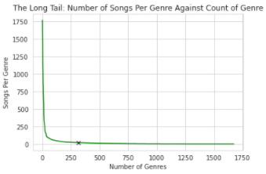
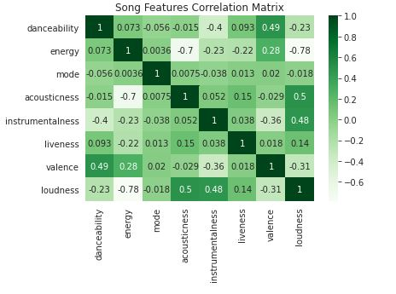
Addition of Polynomial Features, Transformation of Genre Column,
and Creating Dummy Variables Rounds out Data Manipulation
Genre Columns:
Converted column of string representation of lists into 312 binary predictors
Created a dictionary of genre frequencies throughout the dataset and took the mean (21.7)
Created binary predictors for all genres that occurred at least 21 times
Polynomial Features:
Began with the intuition and song feature correlations
Chose song loudness, energy, acousticness, and instrumentalness to take to second degree
Categorical Variables:
Song key, time, release month, album type converted via pd.get_dummies()
BA476 Team 2
Notes:
(becca)
In addition to transforming existing predictors, our team also manipulated and created new predictors. As mentioned earlier, we created 312 binary genre predictors. We did this by creating a dictionary containing the genre names as keys and the frequency of the genres as values. With this dictionary we found the mean genre frequency and created dummy variables for all genres that appeared more that the mean number of times.
We also recognized the possibility of correlation between our predictors. In particular we thought that certain song characteristics such as loudness and energy may be related in some way. Because of this we created a correlation matrix of the song characteristic predictors and found loudness, energy, acousticness, and instrumentalness had fairly strong correlations to each other. Using these, we created polynomial features taken to the second degree.
Lastly, we created some other dummy variables that inclue release month and album type with the pandas get_dummies function. Now I’ll pass it off to Claire

Slide 8
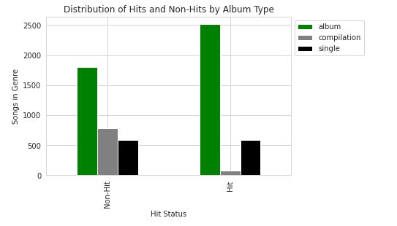
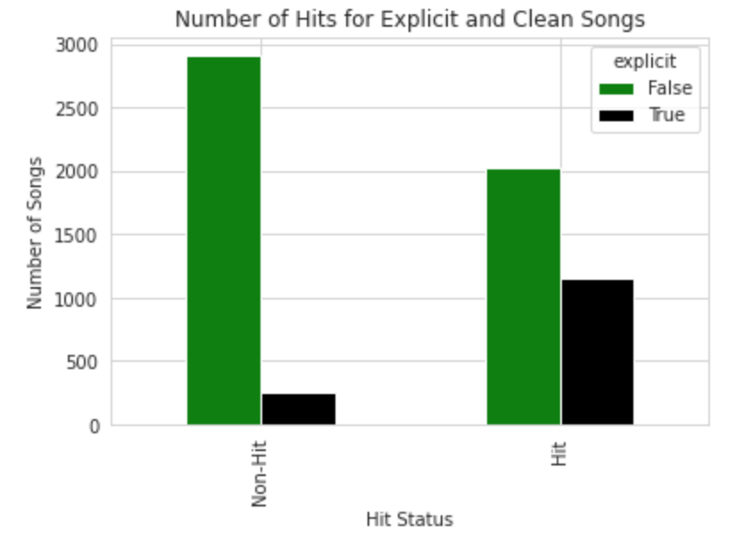
Album Status and Vulgarity Differentiate Instances Between Classes
Few hits come from compilation albums
Hits and non-hits come from singles roughly equally
Hits appear more on albums than others
Explicit songs have a high likelihood of being hits
Clean songs may be hits, but the odds of being a hit go down
BA476 Team 2
Notes:
Claire
Album type found to have high feature importance
Song duration found to have high feature importance

Slide 9
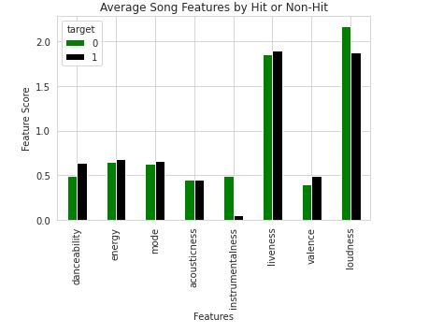
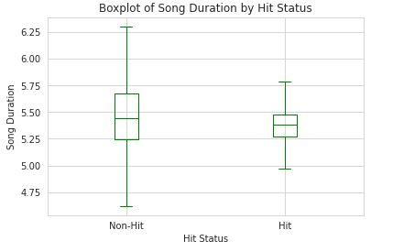
Song Features and Subsequent Distributions Further Differentiate Classes
Despite comparable means, non-hits have a larger standard deviation for durations
Non-hits have higher loudness scores and instrumentalness scores on average
Hits have a slightly larger valence and danceability score
BA476 Team 2
Notes:
Claire

Slide 10
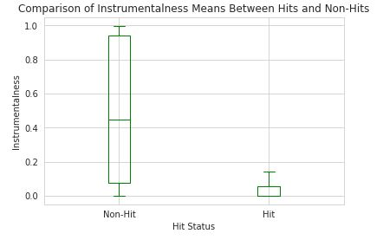
Descriptive Analytics Reveal Trends Related to Later Feature Importances and New Features Drive Best Non-Stacked Model
Feature Importances for Best Non-Stacked Model
instrumentalness² | 0.135061
instrumentalness | 0.126435
loudness instrumentalness | 0.110072
pop | 0.065279
country | 0.048886
rap | 0.046902
alb_type_compilation | 0.045935
Means and standard deviations of instrumentalness scores differ.
This reveals the possibility of instrumentalness as a important feature when building models
Variations of the instrumentalness score are the three most important variables in our best model that is not stacked
6 of the top 7 variables for this model were the result of feature engineering
BA476 Team 2
Notes:
Claire
Instrumentalness score found to have high feature importance
After creating polynomial features with instrumentalness - we have found that the 5 out of the 6 feature in importance include instrumentalness. Though the graph is not shown here, the top feature importance was attributed to instrumentalness prior to the creation of polynomial features as well.

Slide 11
Pre-Tuning Models Show Significant Performance above the Baseline
We employed logistic regression and the ridge classifier to see if regularization would solve our problem
We employed ensemble methods to maximize performance
 | Baseline | LogReg | Ridge Classifier | Decision Tree | KNN | Random Forest | Bagging | Boosting | Stacking
No Tuning | 51.46% | 93.30% | 92.36% | 86.13% | 89.60% | 91.10% | 93.22% | 92.67% | 94.33%
Our baseline was determined using the stratified dummy classifier
We employed non-parametric solvers as a tool to see if it better fit our data and establish a baseline for the tree-based ensembles
BA476 Team 2
Notes:
Tristan
Bottom is most
Pls mention which models (ALL except Baseline) were included in the stacking model

Slide 12
GridSearchCV Beats out RandomizedSearchCV for Parameter Tuning
and the Stacking Ensemble Performs Best
 | Baseline | LogReg | Ridge Classifier | Decision Tree | KNN | Random Forest | Bagging | Boosting | Stacking
Random SearchCV | +0% | +0.08% | -0.08% | +2.84% | -1.26% | +2.75% | +0.47% | +0.10% | -0.32%
Grid SearchCV | +0% | +0% | -0.08% | +2.84% | +0.16% | +2.90% | +0.87% | +0.10% | +0.08%
Best Model Accuracy | 51.46% | 93.38% | 92.36% | 88.97% | 89.76% | 94.01% | 94.09% | 93.77% | 94.41%
For parameter tuning, we ran both GridSearch and RandomizedSearch to improve performance
GridSearch took a long time, but returned the best results after running a RandomizedSearch on a small parameter range
RandomizedSearch was faster, but since it only looks at a few random combinations of parameters, it did not produce the best result on its own
BA476 Team 2
Notes:
Tristan
Bottom is most
Pls mention which models (ALL except Baseline) were included in the stacking model

Slide 13
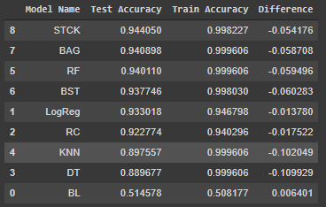
Overfitting Likely Explains Why Stacking and Bagging are the Best Ensembles
Among the ensembles, the best performing models overfit the least
Bagging hyperparameters led to lower variance than the random forest
Stacking with both similar and regularized models introduced different predictions to reduce overfitting
High number of features in our final random forest or high learning rate may have led to the overfitting observed in the model
The regularized models had the least overfitting, but performed worse
BA476 Team 2
Notes:
Tristan
Bottom is most
Pls mention which models (ALL except Baseline) were included in the stacking model

Slide 14
After Struggling with Genres Initially, they Solved our Biggest Roadblock
At first, we struggled to parse out genres from the song instances to create dummy variables.
The genres were placed in the CSV as strings, not lists, requiring extensive processing.
We created a dictionary of all genres and then added features to our model based on whether or not the genre name was found in the genre column.
After discussing with Professor Benade, we realized many of our predictors were unreliable.
For example, artist popularity reflects the current popularity of an artist, not the popularity of the artist when a song debuted.
After removing these predictors, we lost ~10% of our predictive accuracy (95% → 84%).
To combat unrepresentative predictors, we added 302 more genre predictors. This increased predictive accuracy by 10% (84% → 94%) to negate the loss of excluding those predictors
BA476 Team 2
Notes:
Claire

Slide 15
Training the Spotify Models Has Challenged Us to Consider
Predictors and Alternative Tuning Methods
Choosing predictors is not just about accuracy, but also building structurally sound experiments
We learned that variables must be a suitable representation of the data and that time; thinking about predictors without context can create misleading models
Using information from only Spotify only tells us part of the story, finding data from other platforms would be a next logical step to address limitations that come with suitable data
Depending upon time constraints and the project, different tuning methods may be more appropriate
Using RandomizedSearchCV to determine hyperparameter estimates to pass into GridSearches allowed us to achieve optimal accuracy
RandomSearchCV can be a good tool to give relative hyperparameter ranges for the more granular GridSearchCV to explore
In future projects, we will consider the context of the predictors for our stakeholders’ sake
In future projects, we will use the timeline as a guiding principle for which method to select, but if time permits, we will likely use both in tandem to produce the optimal model
BA476 Team 2
Notes:
Tristan
Power of data is based on the hands that you place it in

